Slide 1
Final Project: Auto Removing Distracting People
Proposed: Nguyễn Vĩnh Tiệp
Member: Phạm Quốc Bình - Võ Kế Hoài

Slide 2
Contents
Introduction
1.1 Problem Definition
1.2 Objectives
Proposed Solution Overview
2.1 System Workflow
2.2 Model Components and Pipeline
Experiments and Results
3.1 Evaluation Metrics (Mask AP)
3.2 Comparison: Pretrained vs Fine-Tuned Model
3.3 Visual Results and Analysis
Future Work

Slide 3
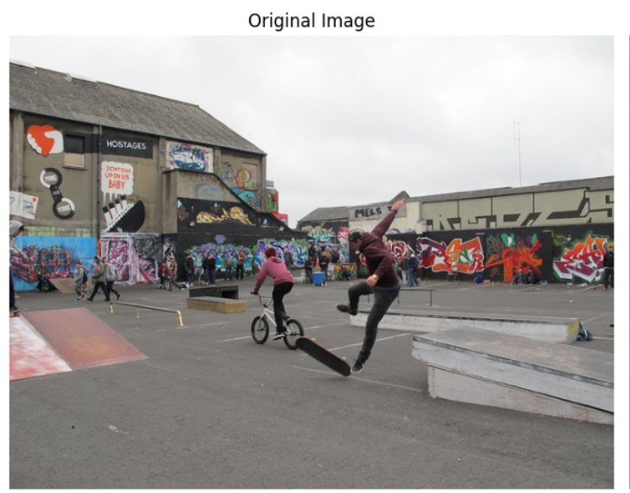
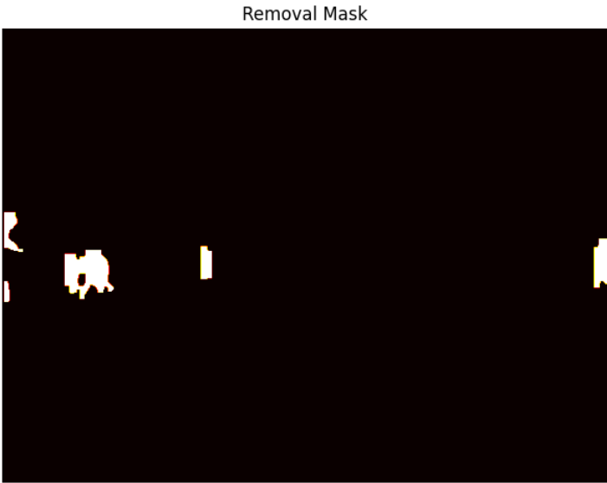
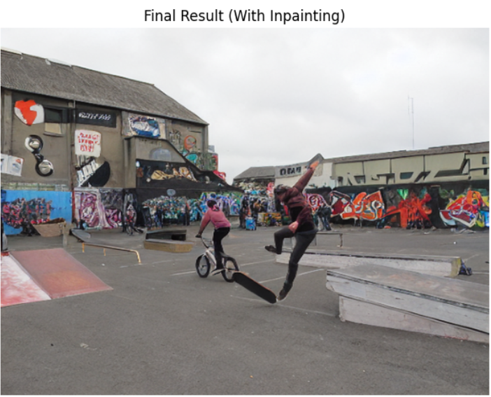
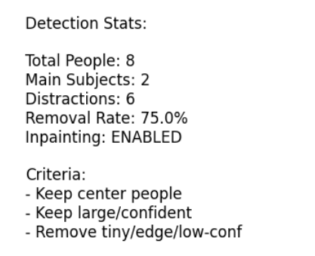
Introduction
Problem Overview:
In many images, background people can be visually distracting and reduce image quality or focus. Our goal is to automatically detect and remove those distracting people while keeping the main subject intact.
Objective:
Detect the main person in the image.
Identify and remove all other people in the background.
Restore the background naturally using inpainting.

Slide 4
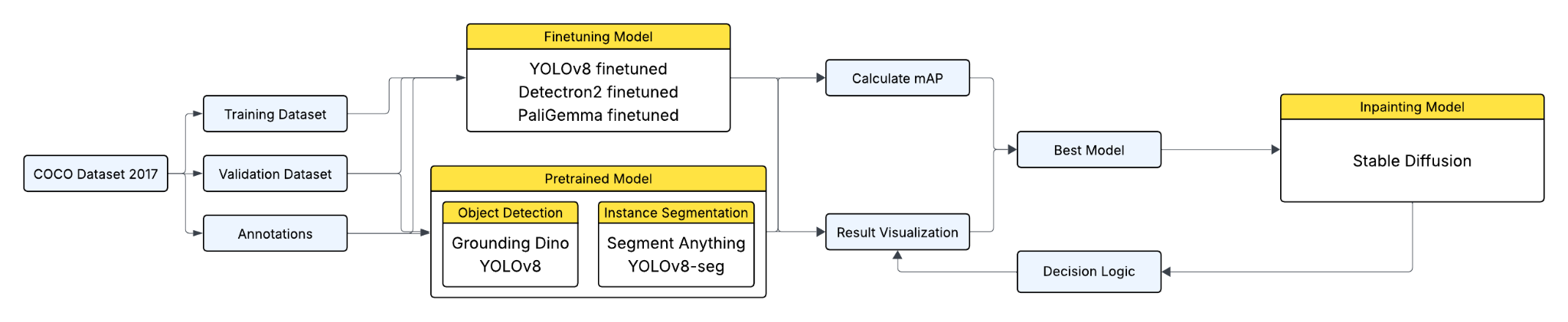
Proposed Solution Overview
System Workflow

Slide 5
Proposed Solution Overview
Model Components and Pipeline
Model Components Explanation:
Component 1: Object Detection Network — detects the all people.
Component 2: Instance Segmentation Network — segments all people individually.
Component 3: Decision Logic — compares detections, identifies distracting/background people.
Component 4: Inpainting Model — removes unwanted regions and reconstructs the background.
Pipeline Explanation:
The pipeline shows how data passes between components — e.g., segmentation masks → filtering logic → masked image → inpainting → final result.

Slide 6
Experiments and Results
 | Detection: Grounding DINO | Detection: YOLOv8 | Detection: Detrecton2 | Segmentation: Sement Anything SAM | Segmentation: YOLOv8-seg | Segmentation: Detrecton2
Original mAP50 | 0.4124 | 0.6055 | 0.7052 | 0.3524 | 0.5872 | 0.6377
Original mAP50-95 | 0.3573 | 0.3846 | 0.5012 | 0.2815 | 0.3045 | 0.4921
Finetuned mAP50 | 0.4589 | 0.6273 | 0.7743 | 0.3860 | 0.6056 | 0.7003
Finetuned mAP50-95 | 0.3715 | 0.4114 | 0.5240 | 0.3022 | 0.3270 | 0.5338

Slide 7
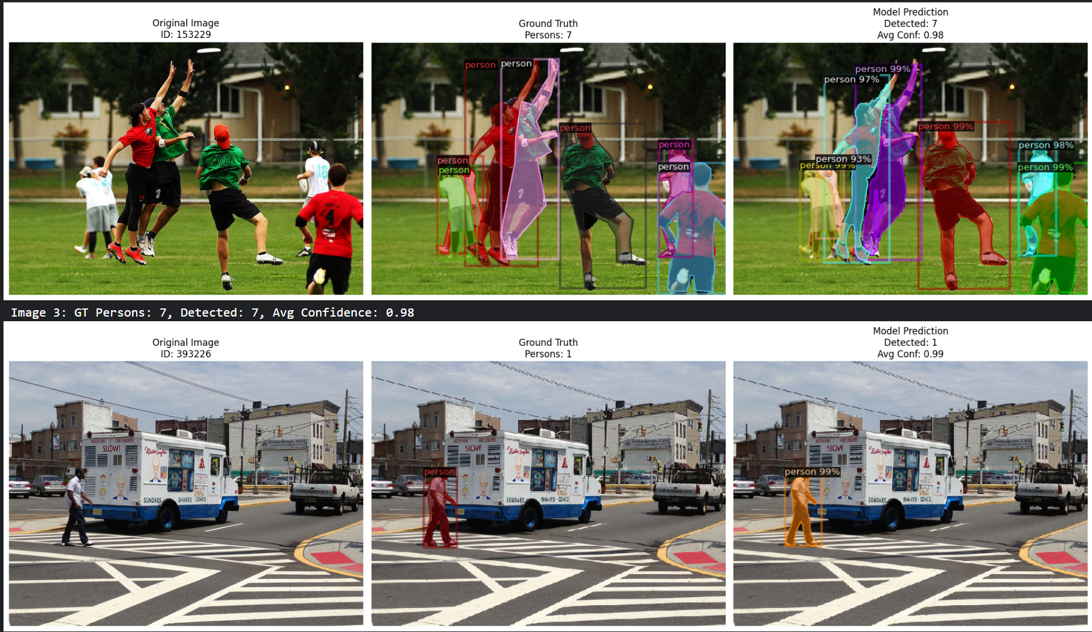
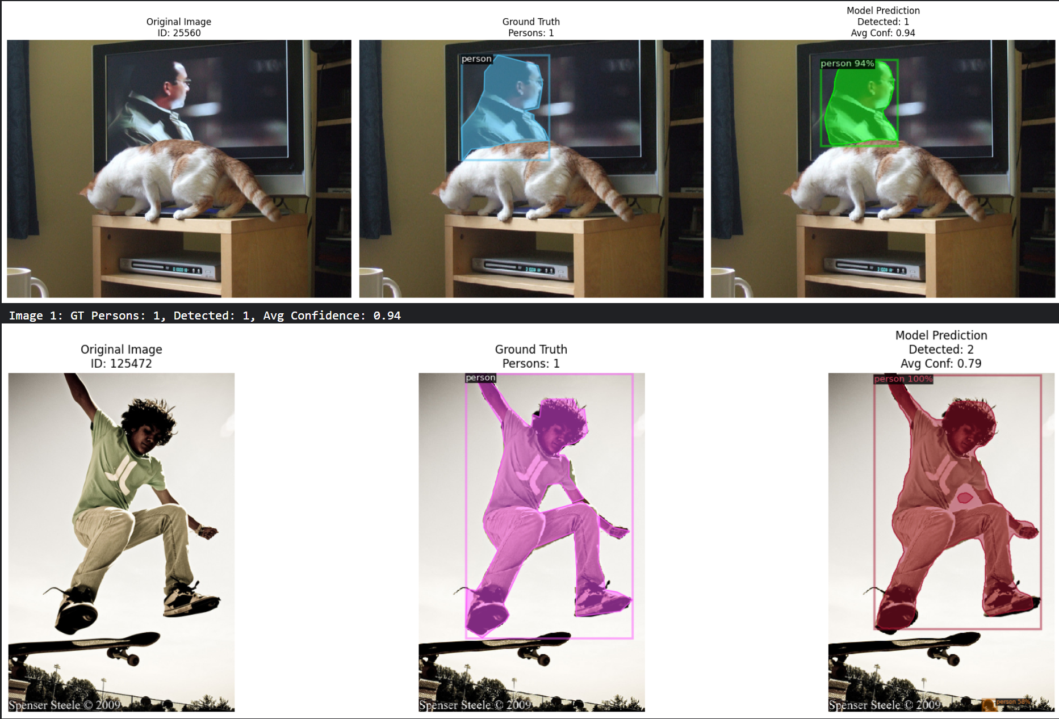
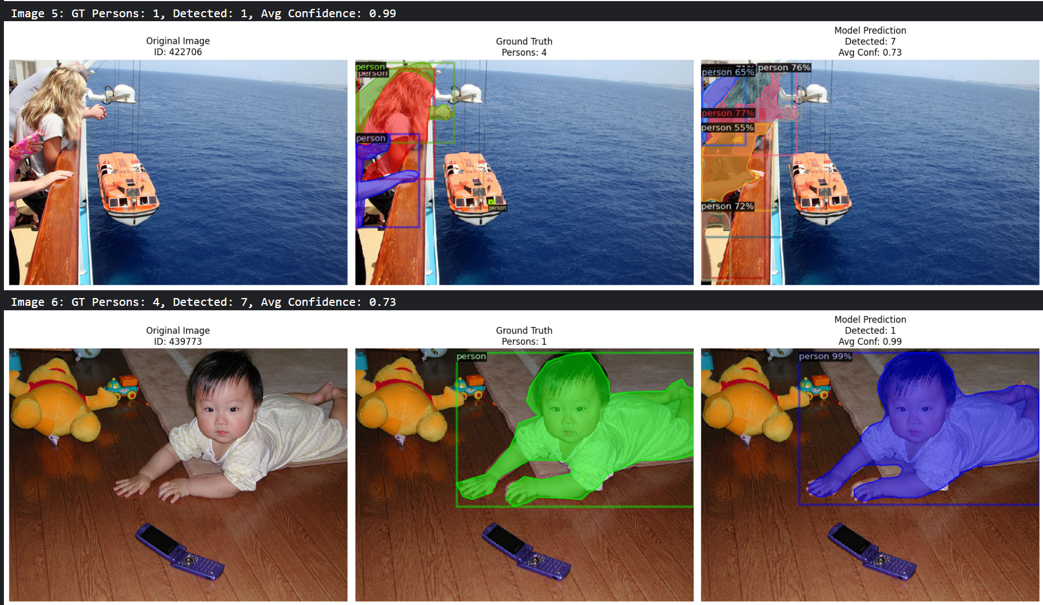
Experiments and Results
Detrecton2

Slide 8
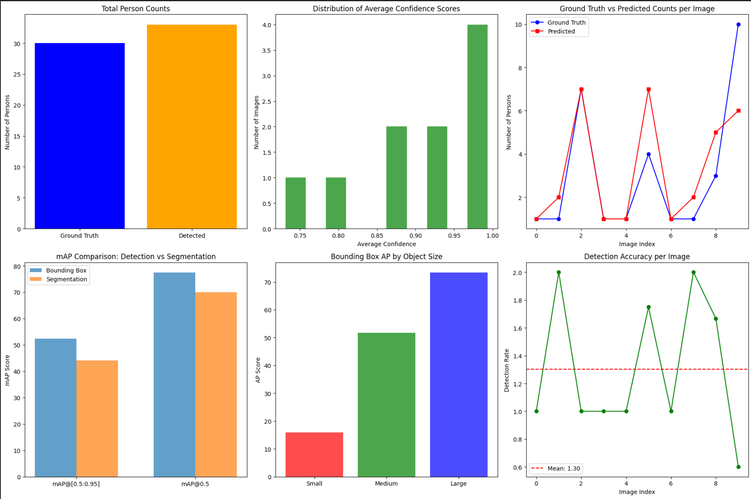
Experiments and Results
Detrecton2

Slide 9
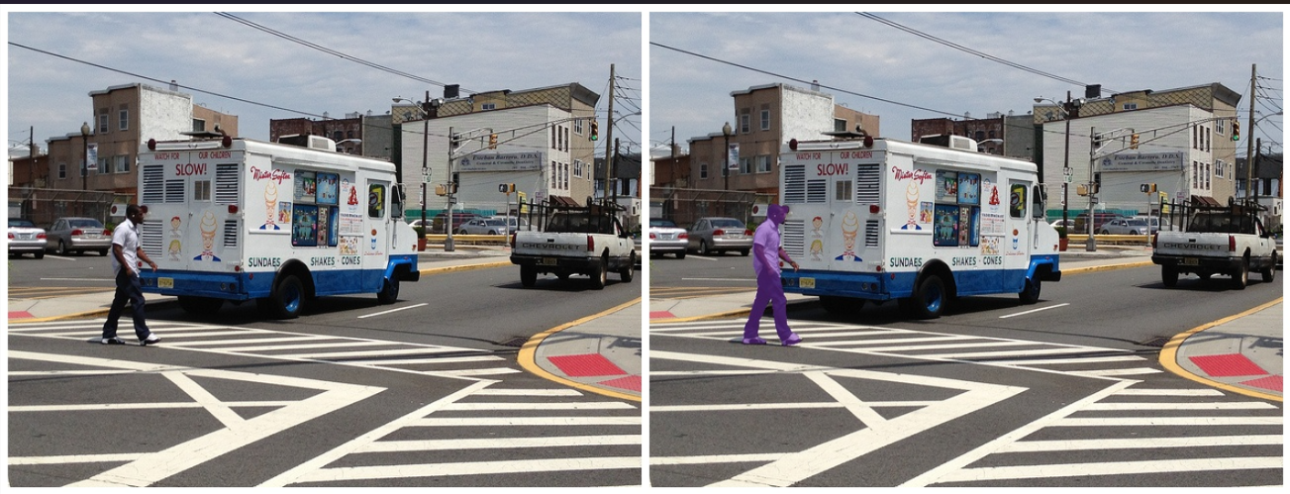
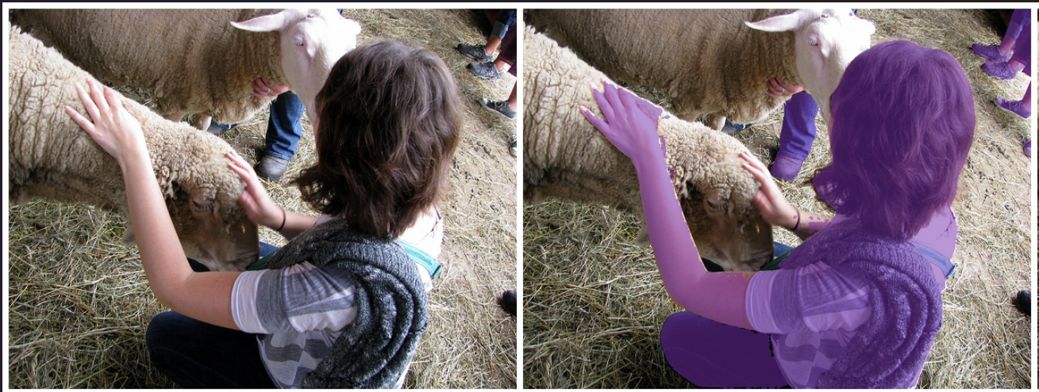
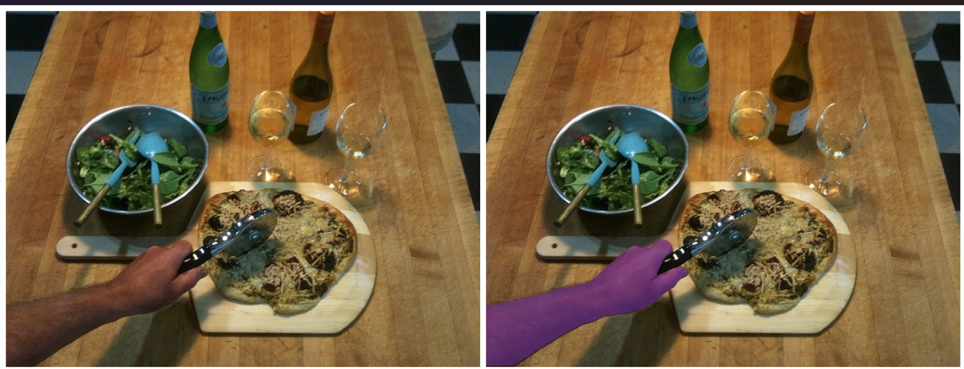
Experiments and Results
Grounding DINO + SAM

Slide 10
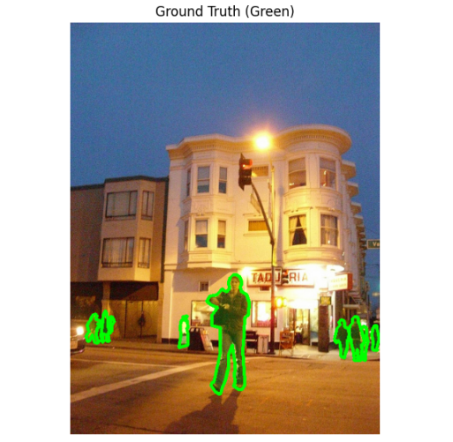
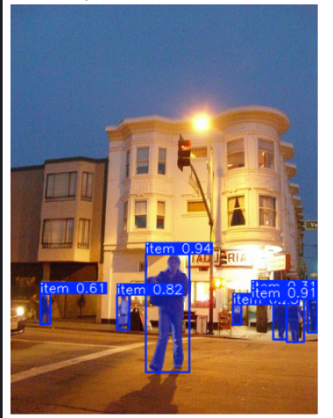
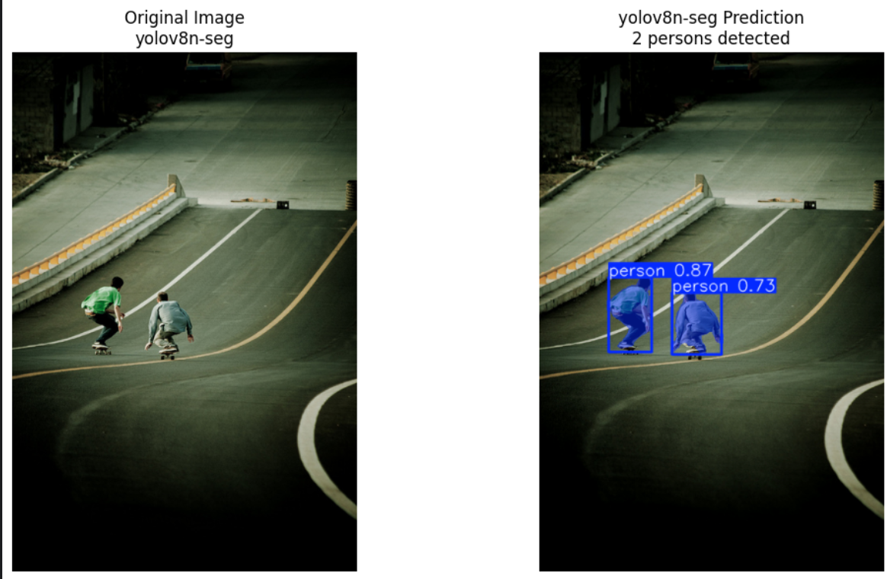
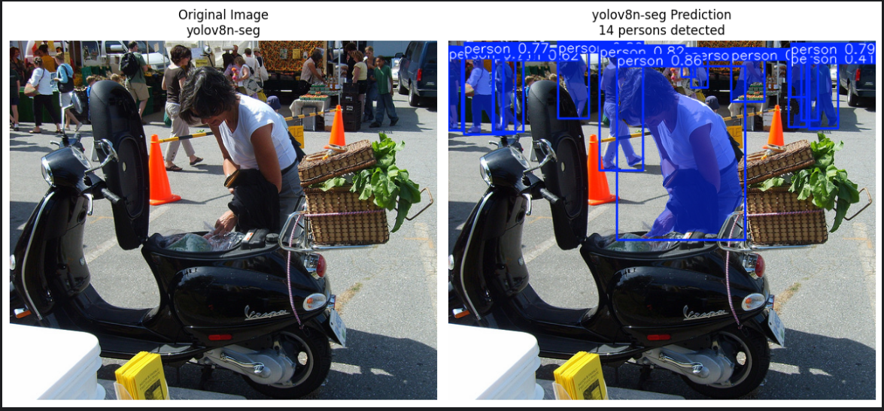
Experiments and Results
YOLOv8: Detection + Segmentation

Slide 11
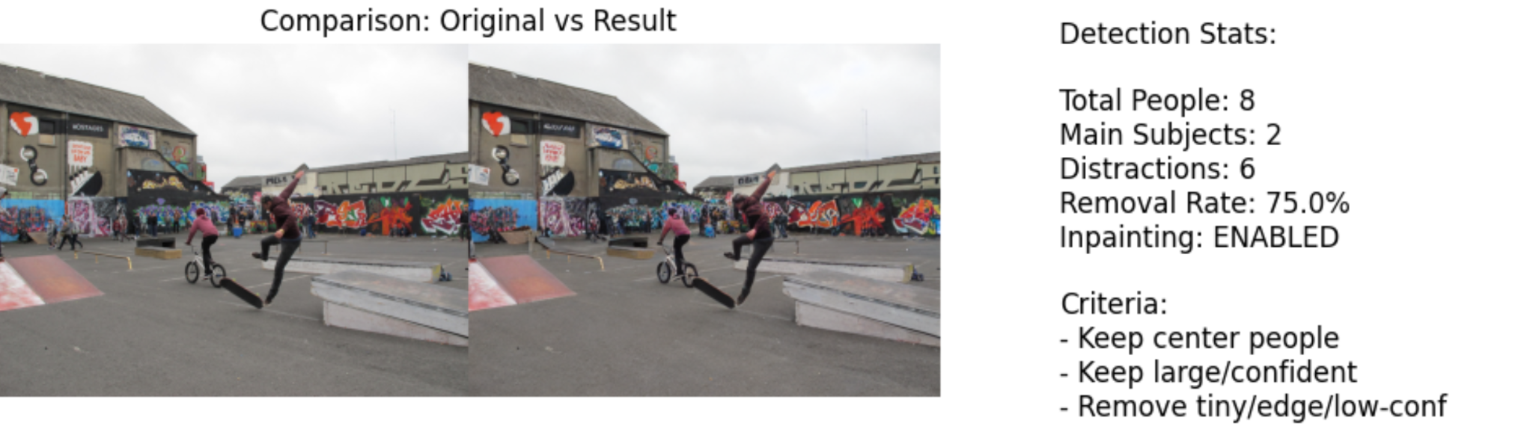
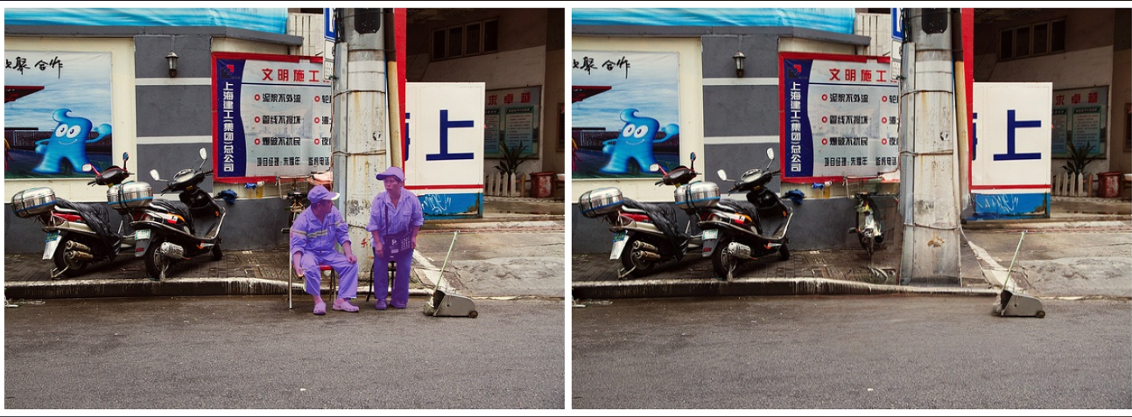
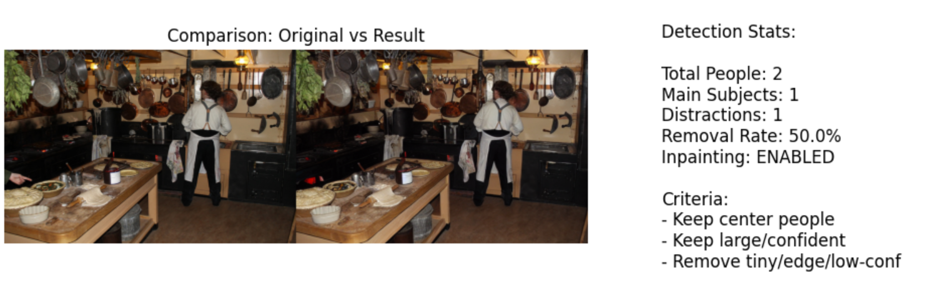
Experiments and Results
Inpainting (Stable Diffusion):

Slide 12
Future Work
Experimenting with more models:
Object Detection + Object Segmentation: PaliGemma (Google), Detectron2, GoogleOwlv2, …
Inpainting Model: MI-GAN, Object Clear, Lama Model, FLUX, ..
Another Logic Flow:
Input → Detection/Segmentation Model → Bounding Box → Image Understanding Model → Large Language Model → Decision Logic → Inpainting Model → Remove the unwanted bounding box

